Slide 1
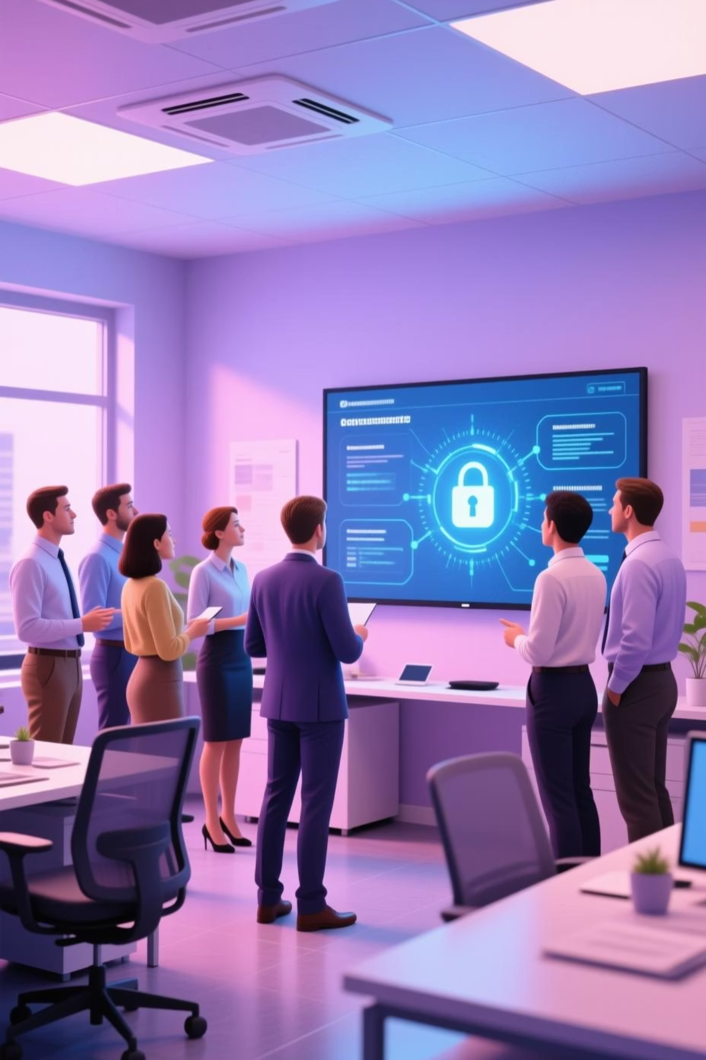
Strengthening Our Defenses: Phishing Awareness Training
In today's digital landscape, cyber threats are constantly evolving. Phishing attacks remain one of the most common and dangerous methods cybercriminals use to gain access to sensitive information. This presentation will equip you with the knowledge and tools to recognize, report, and resist these deceptive tactics, protecting both yourself and our organization.

Slide 2

Agenda
Understanding Phishing Threats
What is Phishing?
Recognizing Common Attacks
Social Engineering Tactics
Best Practices for Protection
Interactive Learning & Next Steps

Slide 3
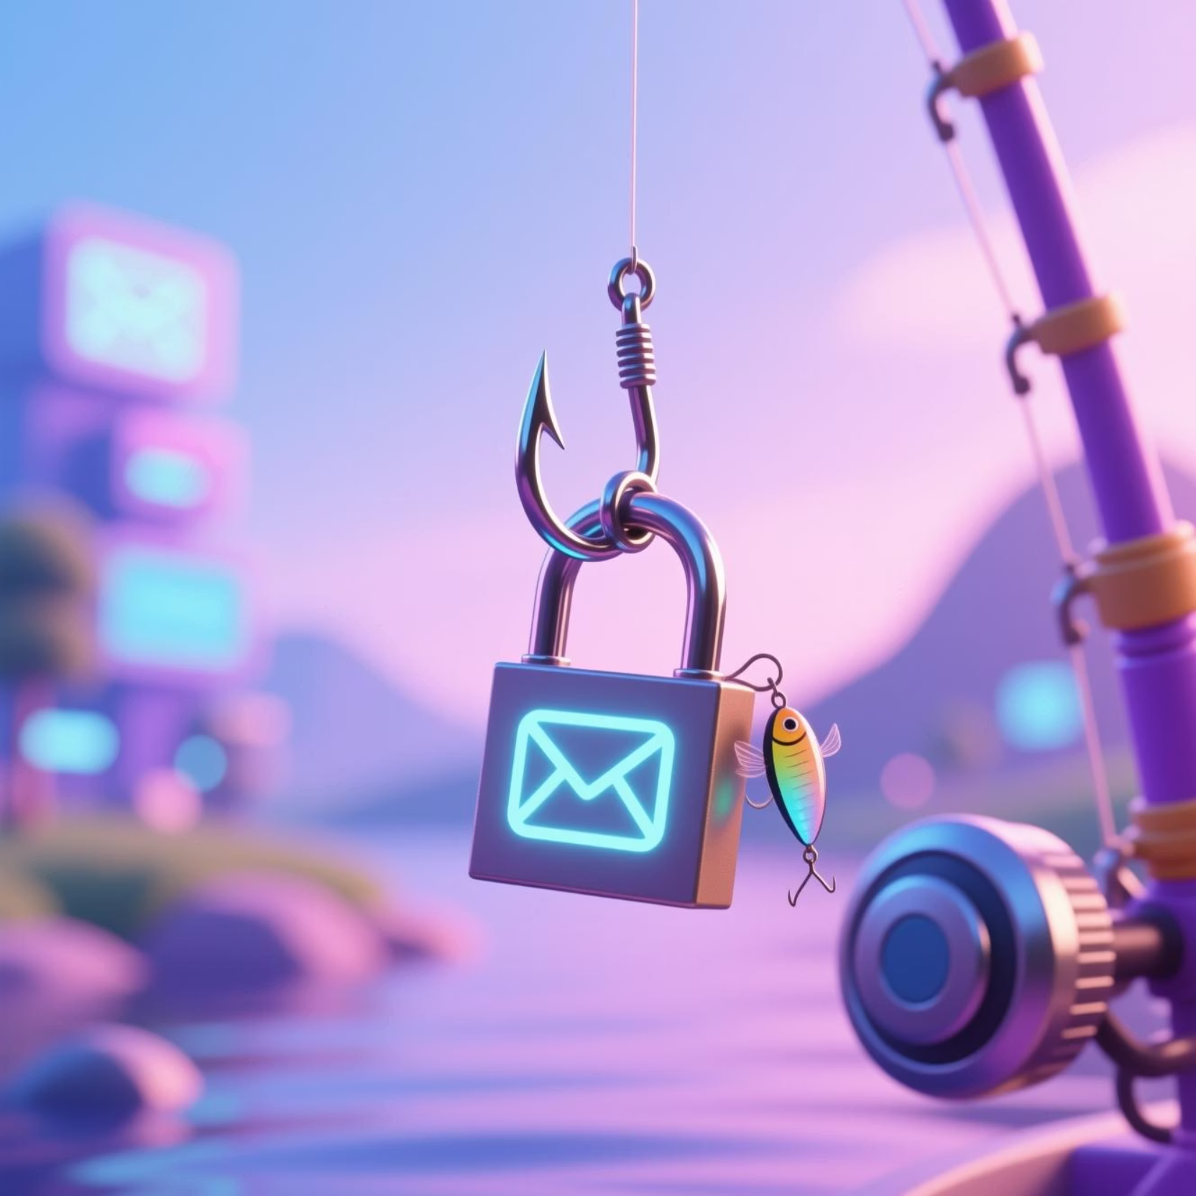
What is Phishing?
Phishing is a type of cyberattack where attackers impersonate trusted entities to trick individuals into revealing sensitive information, such as usernames, passwords, or credit card details. These attacks often come through emails, text messages, or even phone calls.
The goal is to deceive you into clicking malicious links, opening infected attachments, or providing personal data directly to the attacker.

Slide 4

Recognizing Phishing Emails and Fake Websites
Suspicious Links
Poor Grammar & Spelling
Hover over links to check the URL before clicking. Look for mismatches between the displayed text and the actual destination.
Legitimate organizations typically have professional communications. Errors are a common red flag in phishing attempts.
Mismatched Domains
Generic Greetings
The sender's email address or website domain may look similar but won't be exact. For example, "amaz0n.com" instead of "amazon.com."
Many phishing emails use generic greetings like "Dear Customer" instead of your name, indicating a mass unsolicited email.

Slide 5



The Art of Deception: Social Engineering Tactics
Attackers often leverage psychological manipulation to exploit human vulnerabilities. Understanding these tactics is crucial.
Urgency
Fear
Authority
Creating a false sense of urgency (e.g., "Act now or your account will be suspended!") to rush your decision-making.
Threatening negative consequences (e.g., "Your computer has been infected," "Legal action will be taken") to induce panic.
Impersonating authority figures (e.g., CEO, IT Support, government agencies) to command compliance without question.

Slide 6
Best Practices for Protection
Empower yourself with these essential habits to safeguard your digital presence.
1
2
Don't Click Unknown Links
Verify Sender Identity
Never click on links or open attachments from suspicious emails. When in doubt, delete the email.
If an email seems unusual, contact the sender directly through a known, trusted method (not by replying to the suspicious email).
3
4
Use Multi-Factor Authentication (MFA)
Report Suspected Phishing
MFA adds an extra layer of security, making it significantly harder for attackers to access your accounts even if they have your password.
Always report any suspected phishing attempts to our IT security team immediately. Your vigilance helps protect everyone.

Slide 7
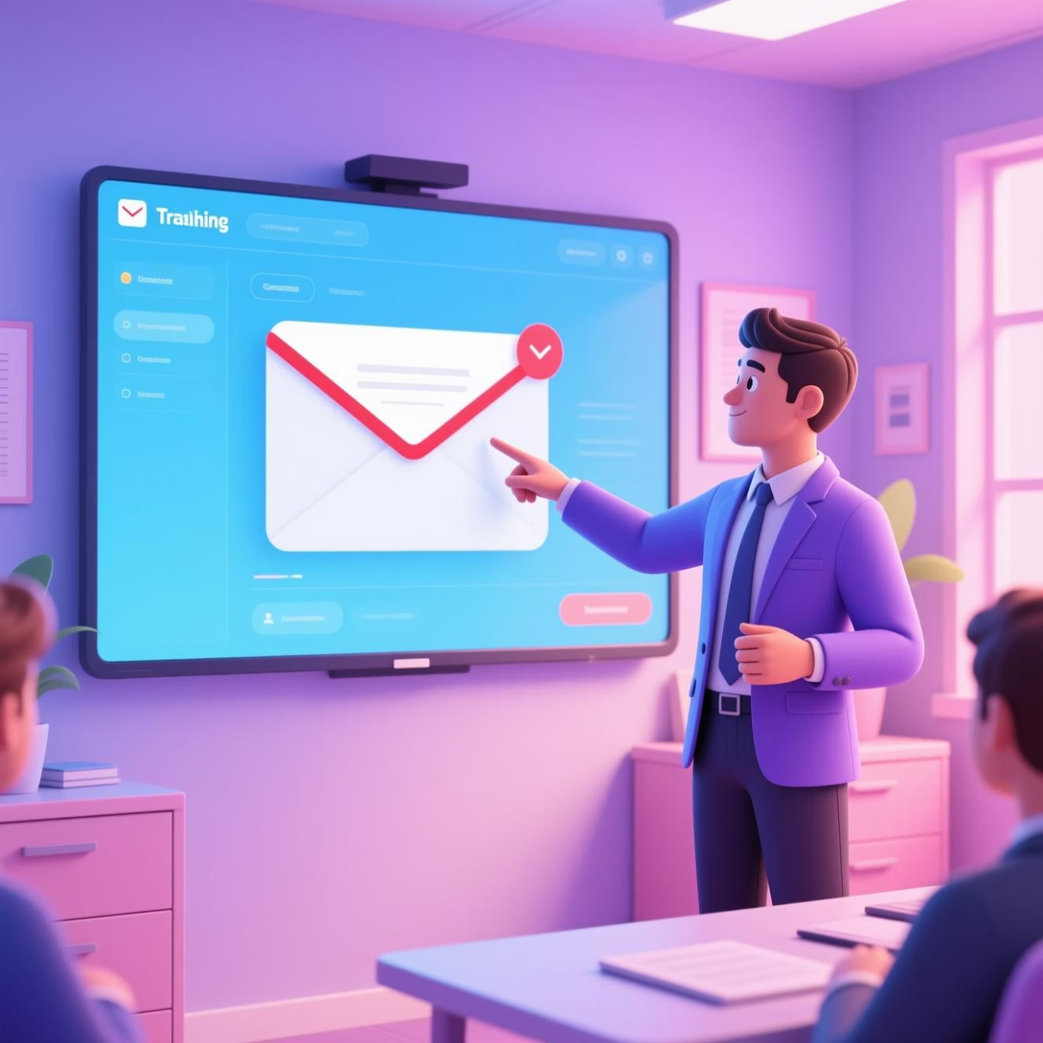
Real-World Examples & Interactive Quizzes
Let's look at some recent phishing examples that have targeted organizations like ours. We'll examine:
Fake Invoice Scams: Emails pretending to be from vendors with attached malicious invoices.
Password Reset Phishing: Emails directing users to fake login pages.
HR/Payroll Impersonation: Attempts to steal employee data or alter direct deposit information.
Following this, we'll have a short interactive quiz to test your newly acquired knowledge. Your participation is key to reinforcing these critical skills!

Slide 8
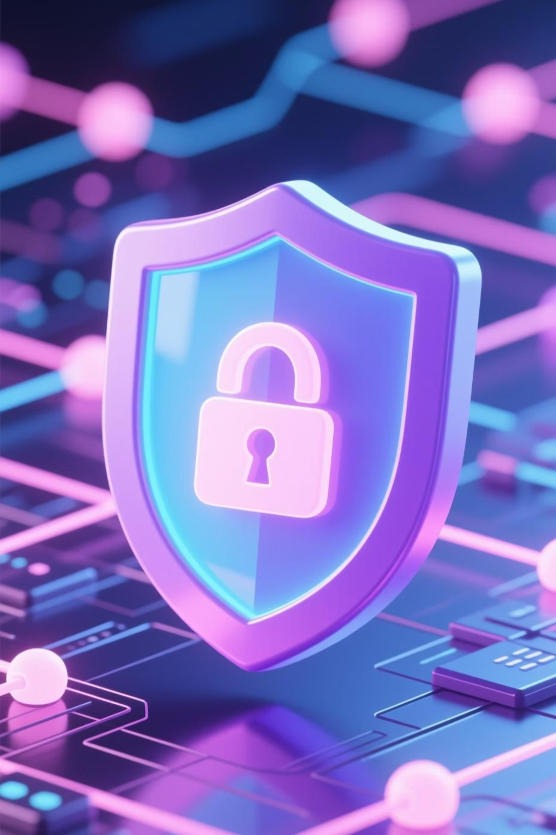
Your Vigilance Is Our Strongest Defense

Slide 9
Key Takeaways
Stay Skeptical
Verify Before Acting
Report & Protect
Always question unexpected emails or messages, especially those asking for personal information or urgent action.
When in doubt, independently verify the request through a trusted channel or contact our IT team.
Reporting suspicious activity promptly helps protect everyone in the organization from evolving threats.

Slide 10



Next Steps & Resources
Continuous Learning
Access our online security awareness module for a deeper dive.
Review our internal guidelines on safe email and internet usage.
Participate in our monthly security tips newsletter.
Need Help?
Contact our IT Security Help Desk at security@yourcompany.com or ext. 1234 for any questions or to report an incident.

